Slide 1
Intro Bootstrap
A Comprehensive Overview of Bootstrap Framework

Slide 2
Bootstrap Overview
What is Bootstrap 5?
History and evolution
Key features of bootstrap 5
Grid System
Introducing Navbar in Bootstrap 5
Form & Tables
Bootstrap Components
Modals, Popovers, and Tooltips in Bootstrap
ScrollSpy in Bootstrap

Slide 3
What is Bootstrap 5?
Bootstrap 5 is the latest version of Bootstrap, a popular open-source front-end framework used for designing responsive and mobile-first websites. It provides a collection of CSS, JavaScript, and prebuilt components to help developers create modern and professional web designs quickly.

Slide 4
History and evolution
2011 (Bootstrap 1): Created by Mark Otto and Jacob Thornton at Twitter to ensure consistent design across web apps.
2012 (Bootstrap 2): Introduced a 12-column grid system and made the framework responsive.
2013 (Bootstrap 3): Shifted focus to mobile-first design with a flat UI approach.
2018 (Bootstrap 4): Added Flexbox, improved customization with Sass, and dropped support for older browsers.
2021 (Bootstrap 5): Removed jQuery, added CSS variables, and introduced new components like offcanvas and improved grid system.

Slide 5
1. Responsive – Adapts to all screen sizes.
2.Prebuilt Components – Ready-to-use UI elements.
3.Customizable – Easy styling with CSS.
4 .Mobile-First – Optimized for mobile devices.
5. No jQuery (Bootstrap 5) – Uses pure JavaScript.
6.Plugins – Adds interactive features like modals
7 cross-Browser – Works on all browsers.
Key Features Of Bootstrap 5

Slide 6
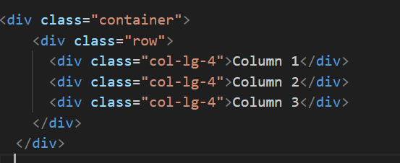
Grid System
Bootstrap 5's grid system is a powerful and flexible layout system built with flexbox. It allows you to create responsive layouts using a series of containers, rows, and columns. The grid system is designed to be fully responsive, adapting to different screen sizes and devices.

Slide 7
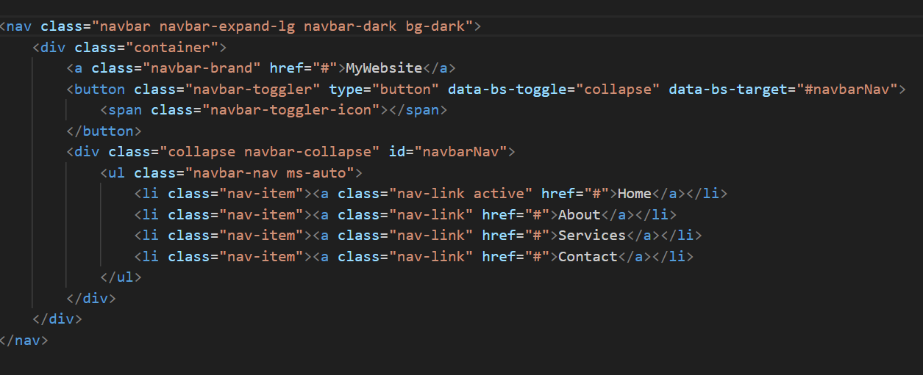
Introducing Navbar in Bootstrap 5
The Navbar is a key component in Bootstrap 5 used to create responsive and flexible navigation bars. It allows you to easily design a navigation menu that adapts to different screen sizes.

Slide 8
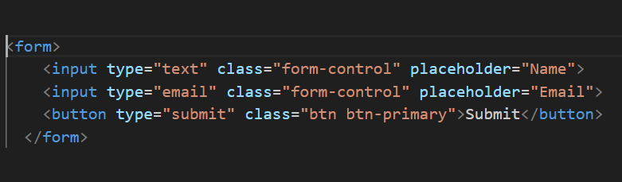
Forms in Bootstrap 5
Bootstrap 5 provides a simple and clean way to create forms with built-in styles and components.
form-label: Labels for form fields.
form-control: Used to style inputs and text areas.
btn: Styles buttons

Slide 9
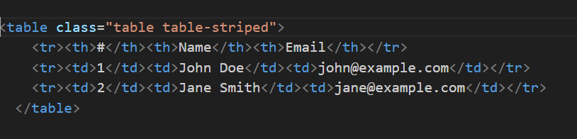
Tables in Bootstrap 5
Bootstrap also makes it easy to create clean, responsive tables with built-in styles.
table: Basic table styling.
thead: Styles for the table header.
tbody: Styles for the table body.
Both forms and tables are easily customizable using Bootstrap classes to create professional, responsive designs.

Slide 10
Bootstrab Components
Button – A clickable element used for actions like submitting forms or opening modals.
Alert – A box used to show messages like success, error, or warnings.
Card – A container used to display content like text, images, and links in a structured format.
Navbar – A navigation bar used to create menus for websites.
Form – Input fields for collecting user data, such as text fields and buttons.
Modal – A popup window used for displaying messages or forms without leaving the page.
Table – A structured format for displaying data in rows and columns.
Progress Bar – A visual representation of progress, like file uploads or task completion

Slide 11
Modals, Popovers, and Tooltips in Bootstrap
1. Modal (Popup Box)
A modal is a dialog box that appears on top of the page, used for alerts, forms, or confirmations.
It requires JavaScript to work.
Users can close it by clicking outside or pressing the close button.
2. Popover (Small Info Box)
A popover is a small popup box that appears when a user clicks an element.
It can contain a title and content.
It requires Bootstrap's JavaScript and Popper.js to function.
3. Tooltip (Hover Message)
A tooltip is a small text box that appears when hovering over an element.
It provides extra information without cluttering the page.
It requires JavaScript to initialize.

Slide 12
ScrollSpy in Bootstrap
ScrollSpy :is a Bootstrap component that automatically updates the navigation links based on the user's scroll position. It highlights the active section in the navigation menu as the user scrolls down the page.
How ScrollSpy Works?
It listens for the scroll event on the page.
As the user scrolls, it checks which section of the page is currently in view and updates the navigation to highlight the corresponding link.
Key Features
It works on navigation bars or any list of links (e.g., table of contents).
It dynamically changes the active class on the corresponding link.
How to Use ScrollSpy?
Set up the page structure: You need sections with IDs and corresponding links in the navbar.
Activate ScrollSpy: Apply the data-bs-spy="scroll" attribute to the body or a container, and specify the target (e.g., a navbar).
Customize the scroll target: Use the data-bs-target attribute to link to the navigation that should be updated.

Slide 13

Travel Website
Welcome to my website! This is a platform where I showcase my projects and ideas. Here, you will find interesting information about websites, applications, and the services I create. My goal is to make it easy for you to access high-quality and modern services

Slide 14
Thank you! 😍

